Slide 1
PERMUTATION AND COMBINATION

Slide 2
Permutation and Combination
Permutation
If we are given a number of objects, we may arrange them in different ways. How many different orders can the objects be placed ?

Slide 3




Example
There are 5 routes for going from A to B, 3 routes for going from B to C and 7 routes for going from C to D. Find in how many different ways can a person go from A to D .
The number of different ways for going from A to D is

Slide 4
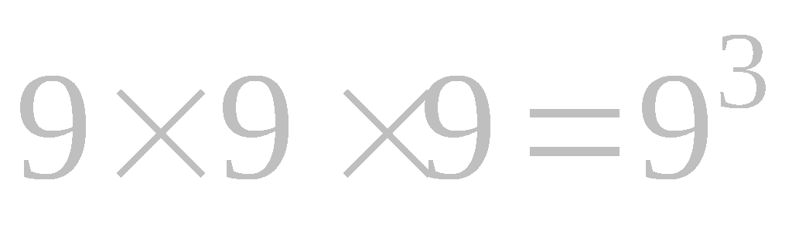
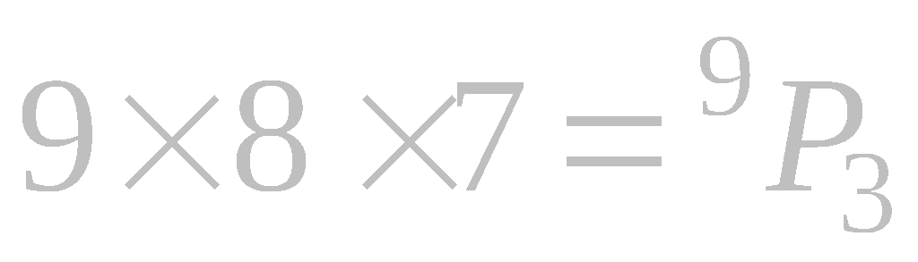
Three digits number formed from 1 to 9 digits
May be repeated
May not be repeated
The symbol ^{n}P_{r} usually denotes the numbers of permutations of n things taken r at a time.

Slide 5

Fundamental Principle
If one operation can be performed in m ways, and then second can be performed in n ways, and a third in p ways, and so on
The number of ways of performing all operations in succession will be

Slide 6


Permutation in which the Quantities may be Repeated
The number of permutation of n things taken r at a time when each thing may
occur any number of times is

Slide 7

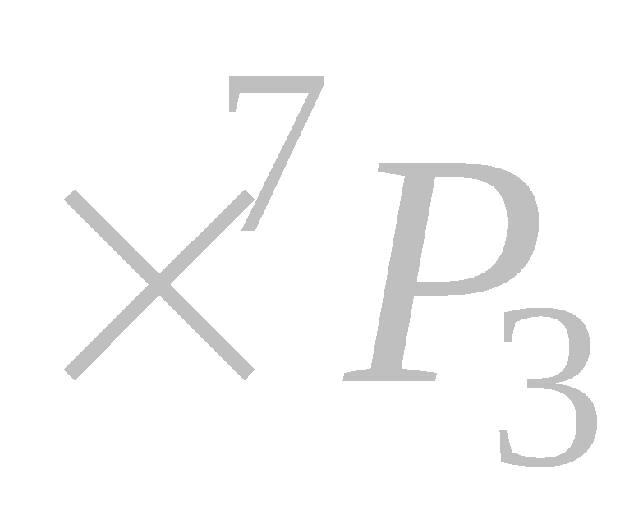


Pg.
How many numbers between 3000 and 7000 can be formed by using the digits 1 , 2 , 3 , 4 , 5 , 6 , 7 , 8 each not more than once in each number ?
The named of digits are 1, 2 , 3 , 4 , 5 , 6 , 7 and 8.
The number of arrangement ways so
that between 3000 and 7000 =
( Not repeated )
__ / __ __ __
( may be repeated )
__ / __ __ __

Slide 8





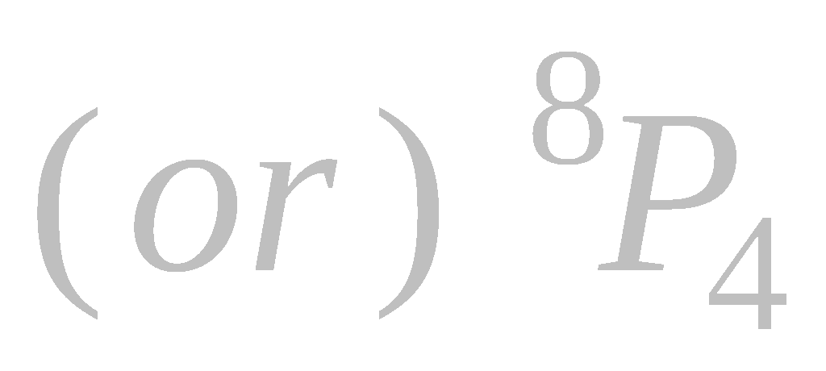


The number of arrangement ways so that between 300 and 60000 each digits not more than once =
_ _ _ + _ _ _ _ + _ _ _ _ _
The number of arrangement ways so that between 300 and 60000 each digits may be repeated =
_ _ _ + _ _ _ _ + _ _ _ _ _
The no. of even numbers so that between 100 and 100000 each digits not more than once =
The no. of odd numbers so that between 100 and 100000 each digits may be repeated =

Slide 9
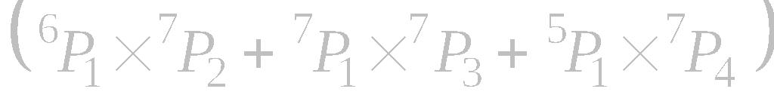

How many numbers between 300 and 70000 can be formed by using the digits 0 , 2 , 3 , 4 , 5 , 6 , 7 , 8 each not more than once in each number ?
The name of digits are 0 , 2 , 3 , 4 , 5 , 6 , 7 and 8
The number of arrangement ways that between 300 and 70000 each digits not more than once =
_ _ _ + _ _ _ _ + _ _ _ _ _
The number of arrangement ways that between 300 and 70000 each digits may be repeated =

Slide 10
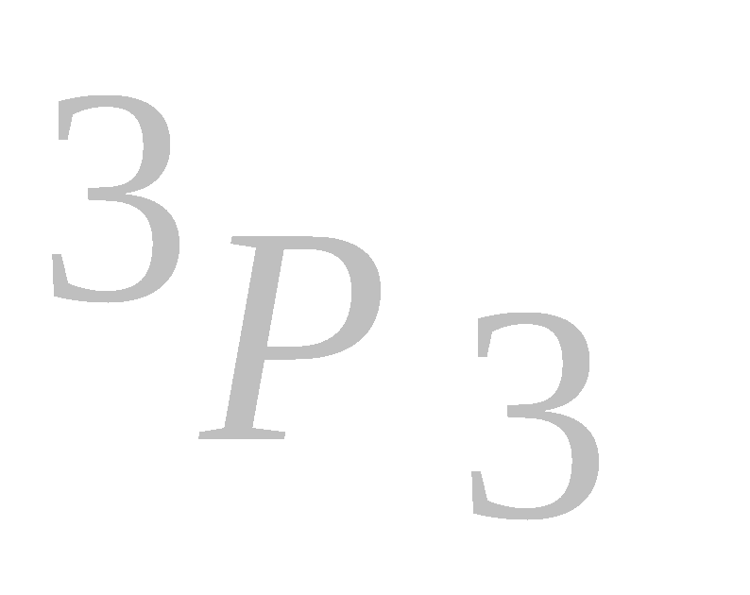
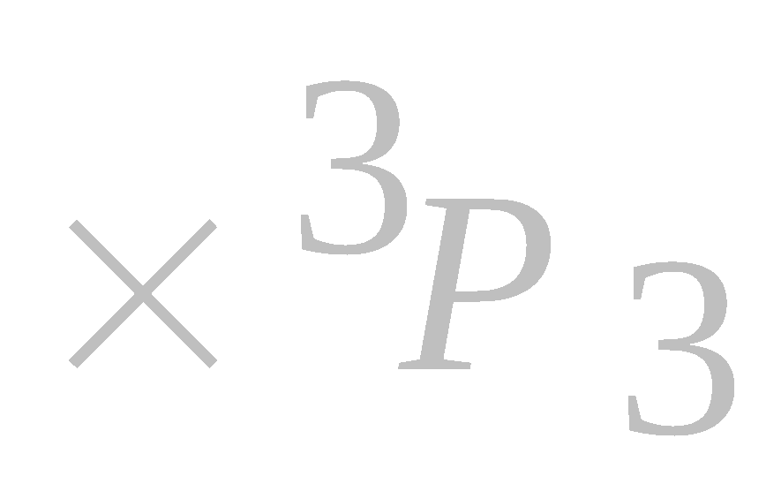
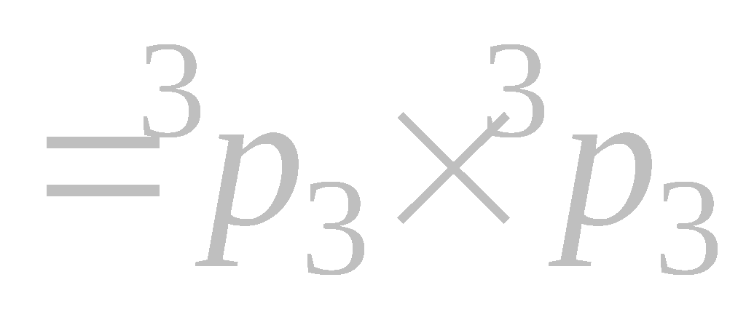
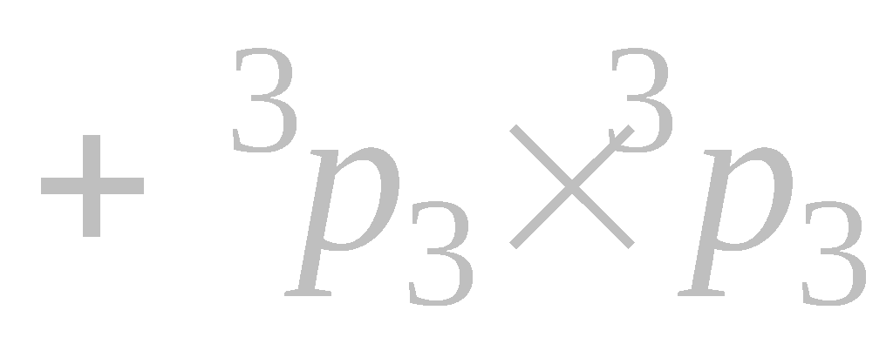
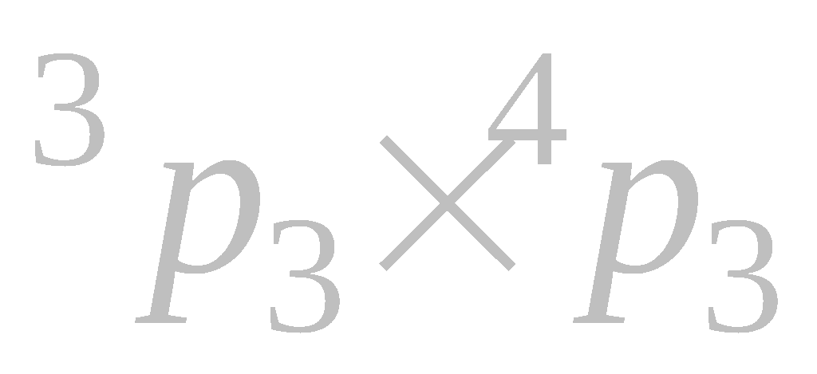
Pg.18 , No.6.
In how many ways can 3 different copper coins and 3 different silver coins be arranged in a line so that the silver coins may be in the odd place
S C S C S C
The no. of ways that silver coins are odd place
The no. of ways that alternately
S C S C S C + C S C S C S
The no. of ways that silver coins are not adjacent = ?

Slide 11

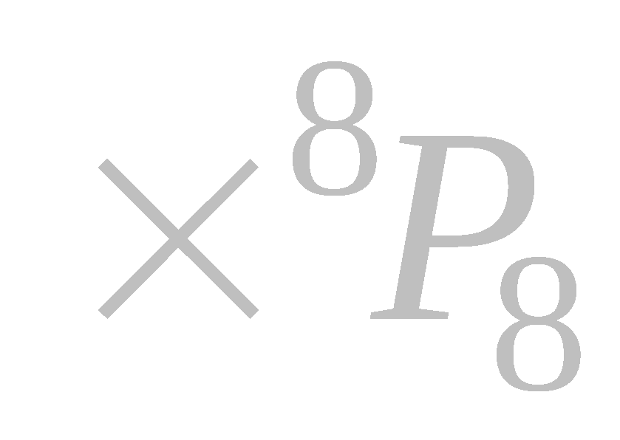

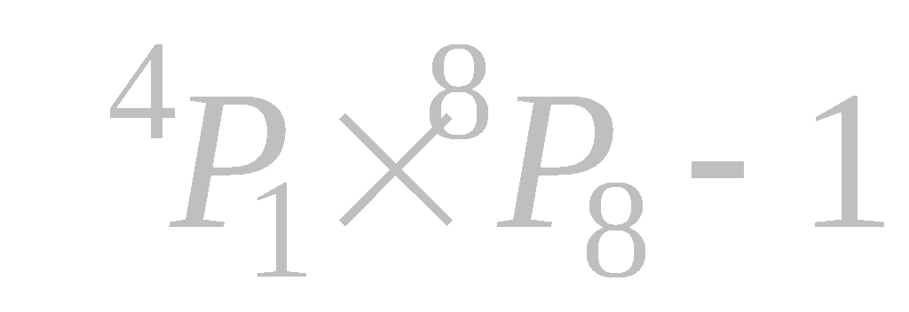
Pg.18 , No.5.
How many new words can be formed by using the letters of the word – UNIVERSAL so that the central letter may be the vowel.
In the word UNIVERSAL ,there are 9 letters
The number of vowels = 4
The number of words can be formed such that central as a vowel =
__ __ __ __ __ __ __ __ __
The number of new words can be formed such that central as a vowel =

Slide 12

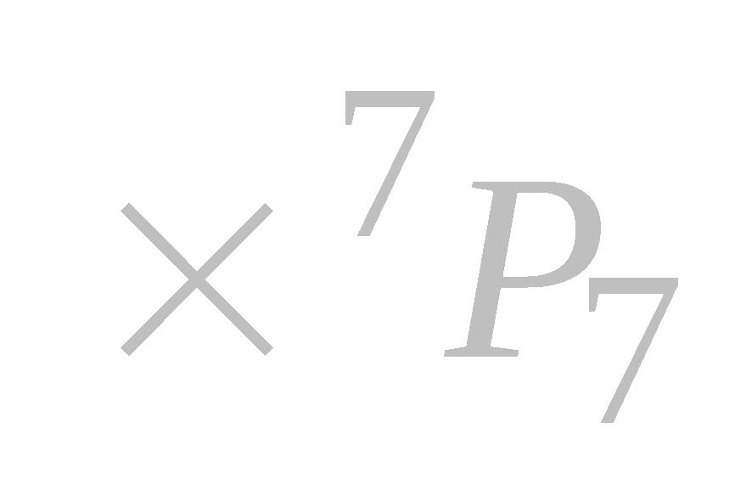


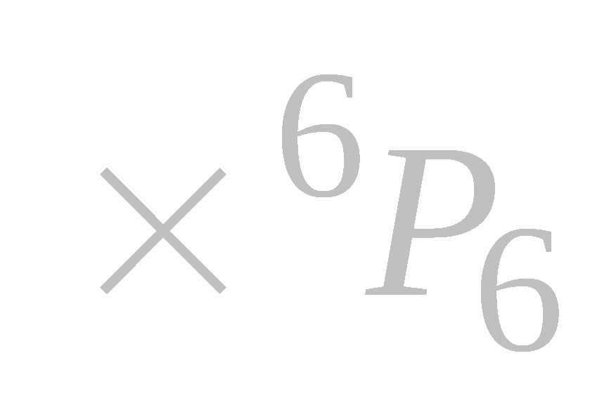
The number of words can be formed such that begin and end with consonants =
__ __ __ __ __ __ __ __ __
The number of words can be formed such that central letter may be vowel and begin and end with consonants =
__ __ __ __ __ __ __ __ __

Slide 13

Central‘ V’
Begin ,end ‘C’
Central ‘V’ and begin,end not ‘C’
Begin,end ‘C’ and central not ‘V’
Central ‘V’ and begin,end ‘C’

Slide 14
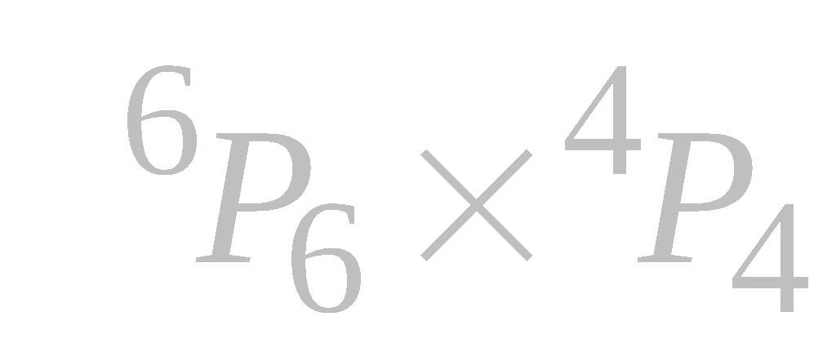

The number of words can be formed such that all vowels are together =
V V V V
C
C
C
C
C
The number of words can be formed such that all vowels are separated =
C
C
C
C
C

Slide 15
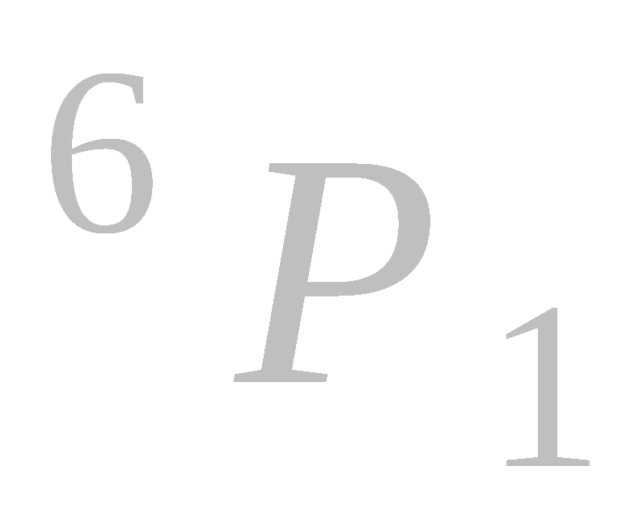
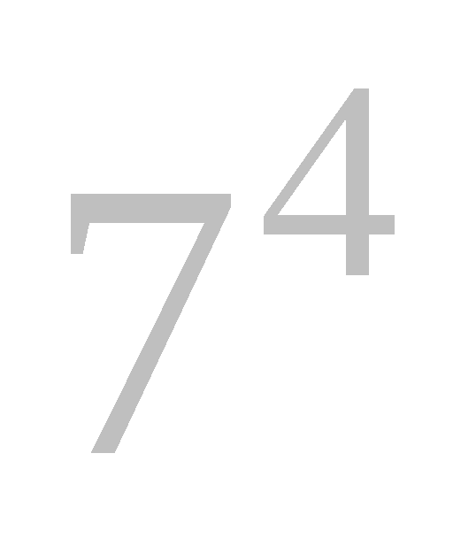
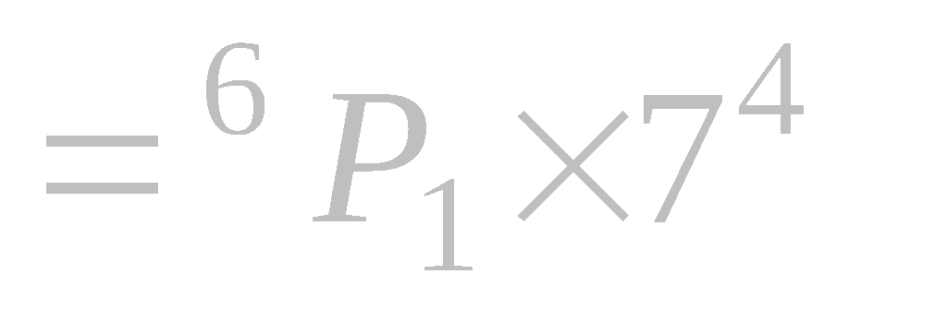
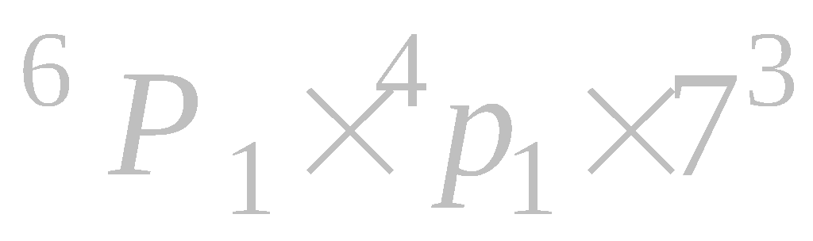
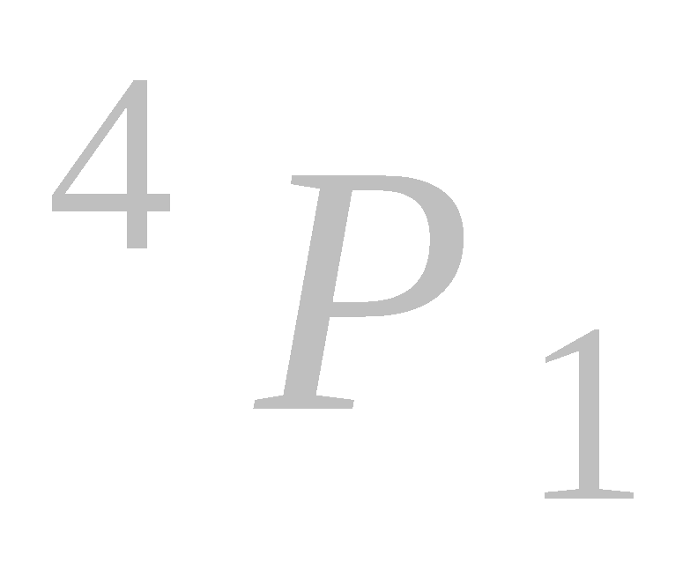
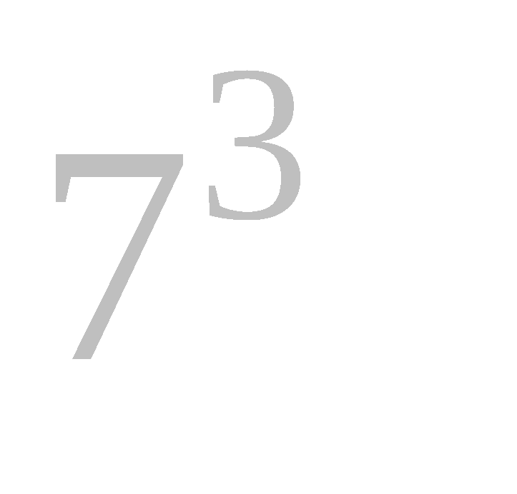
Pg26, No.17.
How many number of 5 digits can be formed with 0 , 1 , 2 , 3 , 4 , 5 and 6 , if each of these digits may be repeated? Of these how many are even and how many are divisible by 5?
The digits are 0 , 1 , 2 , 3 , 4 , 5 , 6
__ __ __ __ __
( i )The numbers of 5 digits can be formed
( ii )The no. of 5 digits even number =
__ __ __ __ __

Slide 16
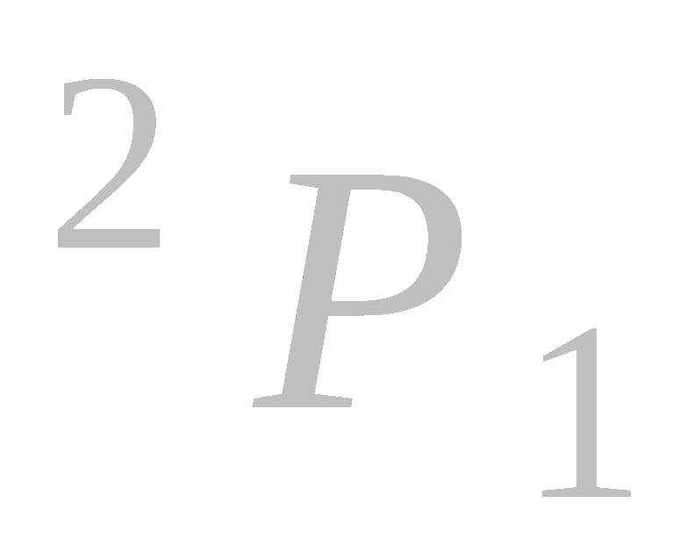
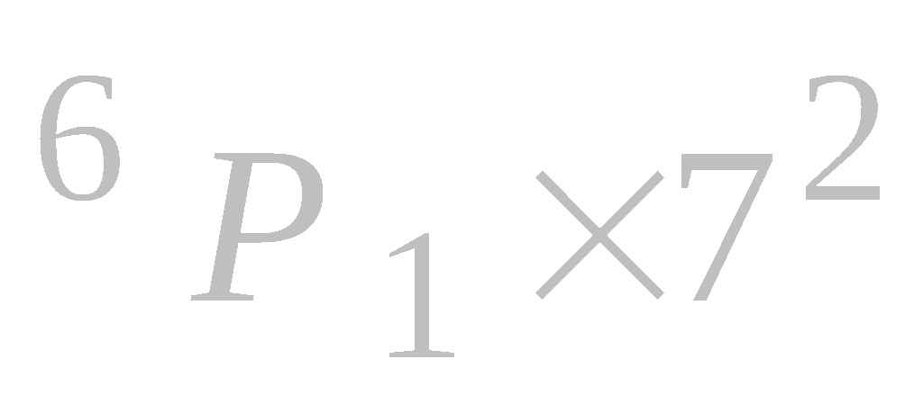
__ __ __ __ __
( iii )The no. of 5 digits number which is divisible by 5 =
( iv )The no. of 5 digits number which is divisible
by 25 =
_ _ _ 0 0 + _ _ _ 2 5 + _ _ _ 5 0
Consider, the no. of 5 digits number each digits not more than once.

Slide 17
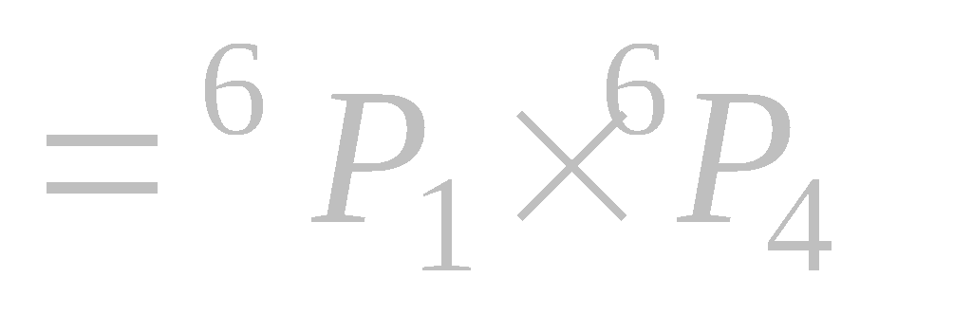
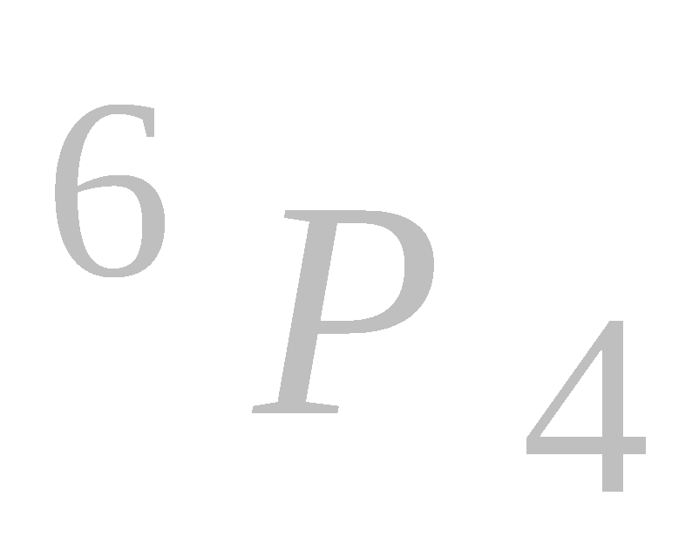


The digits are 0 , 1 , 2 , 3 , 4 , 5 , 6(not repeated )
( i )The numbers of 5 digits can be formed
__ __ __ __ __
( ii )The no. of 5 digits even number = ?
_ _ _ _ 0 + _ _ _ _ not zero
( iii )The no. of 5 digits number which is divisible by 5 = ?
_ _ _ _ 0 + _ _ _ _ 5

Slide 18
( iv )The no. of 5 digits number which is divisible
by 25 = ?

Slide 19

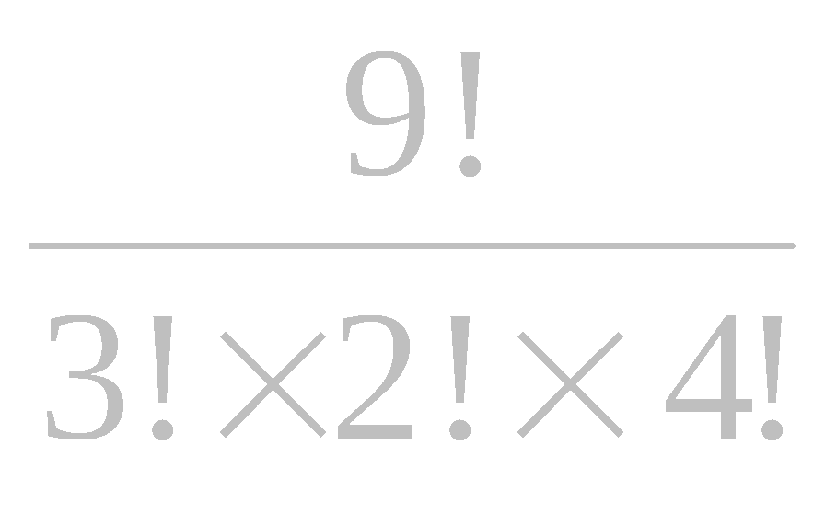
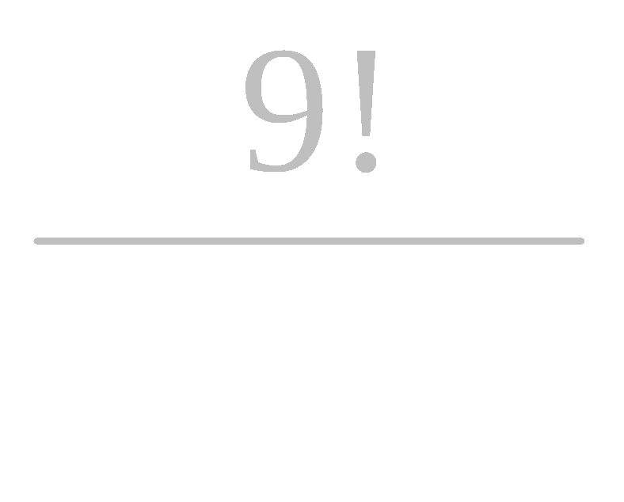
Permutation of n things not all different
Let n things be represented by letters, and p of them are alike, q of them are alike, of them are alike; and so on.
The required number of permutations is
A A A B B C C C C
A A A B B C C C C
A A A B B C C C C and so on

Slide 20
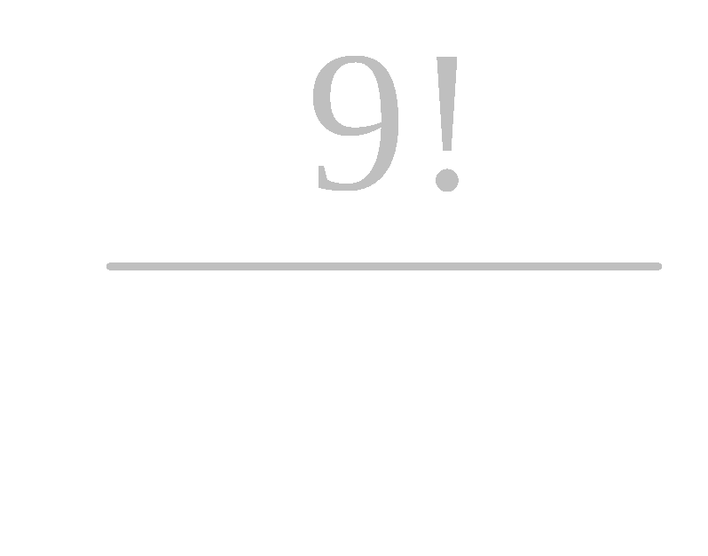
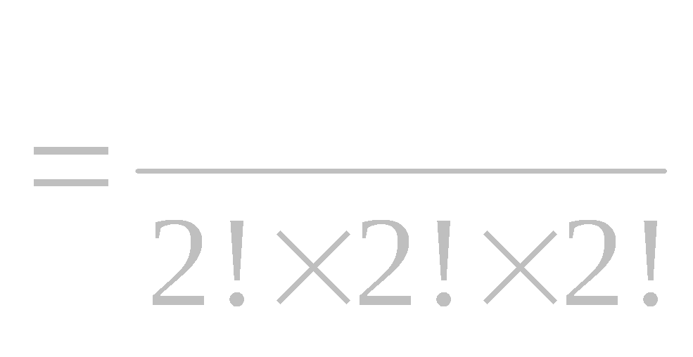
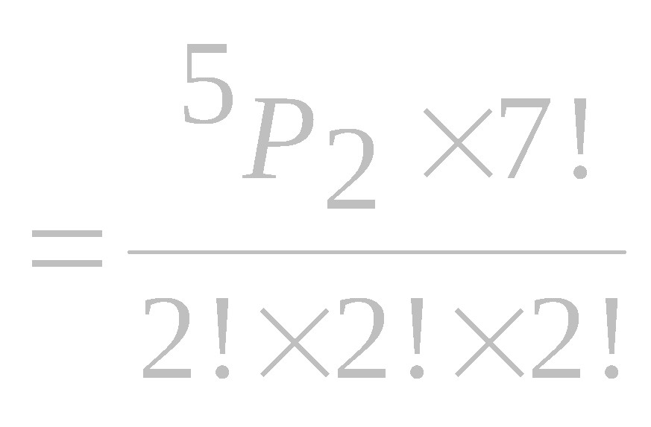
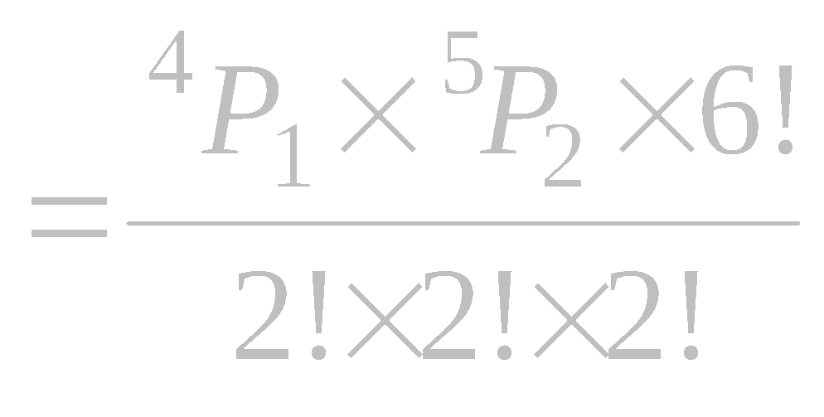

Pg.26,No.18.
In the word COMMITTEE, there are 9 letters, 1 C's , 1 O's , 2 M's , 1 I's , 2 T's and 2 E's .
The no. of total arrangement ways
The no. of ways that begin and end with consonants
__ __ __ __ __ __ __ __ __
The no. of ways that central letters may be vowels and begin and end with consonants
__ __ __ __ __ __ __ __ __

Slide 21
The no. of ways that all vowels are always come to appear together = ?
The no. of ways that all vowels are not come to appear together = ?
The no. of ways that all vowels are to be
separated = ?

Slide 22
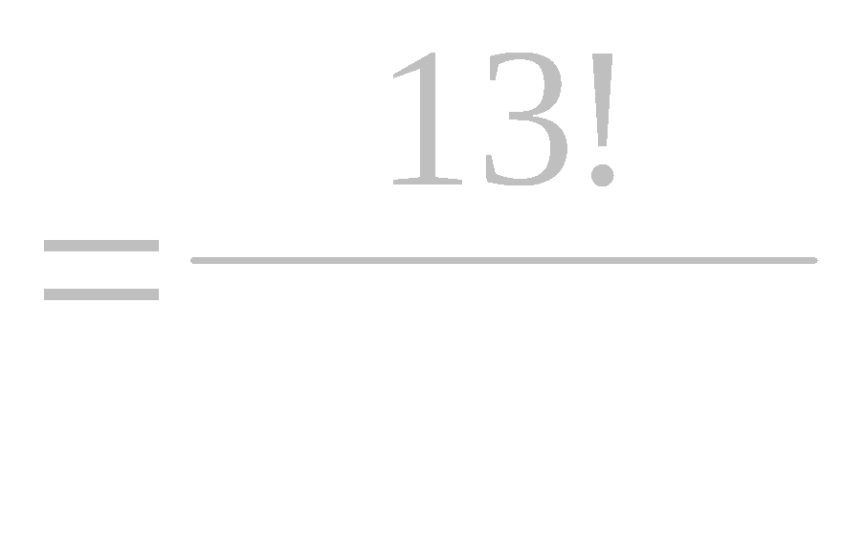
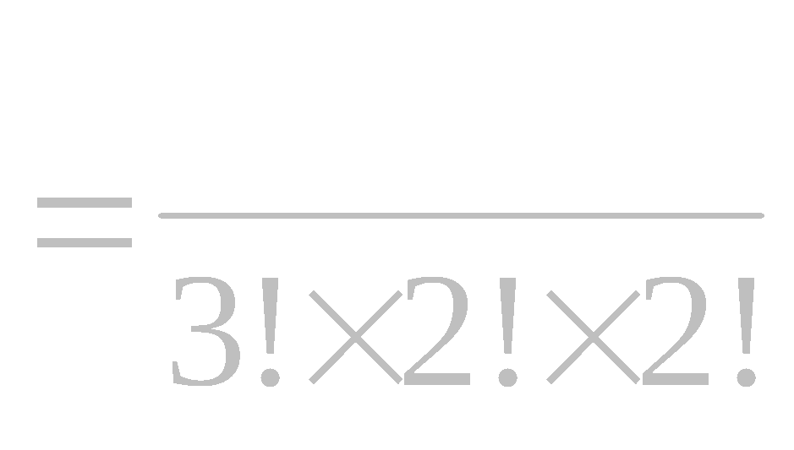
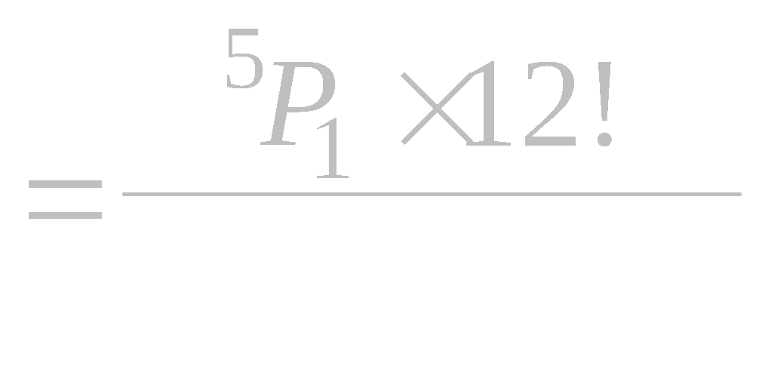
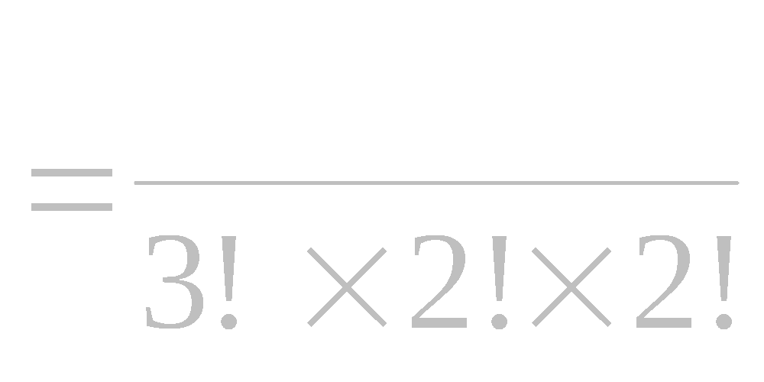
In the word INFINTTESIMAL, there are 13 letters, 3 I's , 2 N's , 1 F's , 2 T's , 1 E's , 1 S's , 1 M's 1 A's and 1 L's .
The number of vowels = 5
The number of arrangement ways
The number of arrangement ways such
that vowel as a central
The number of arrangement ways such
that all vowel always come together

Slide 23
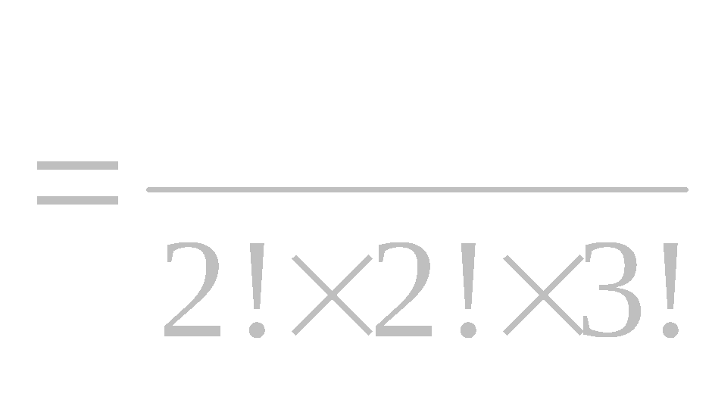
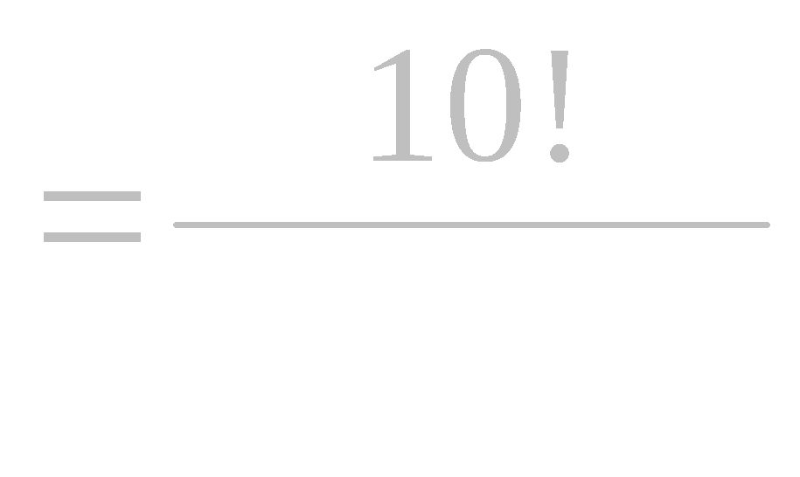

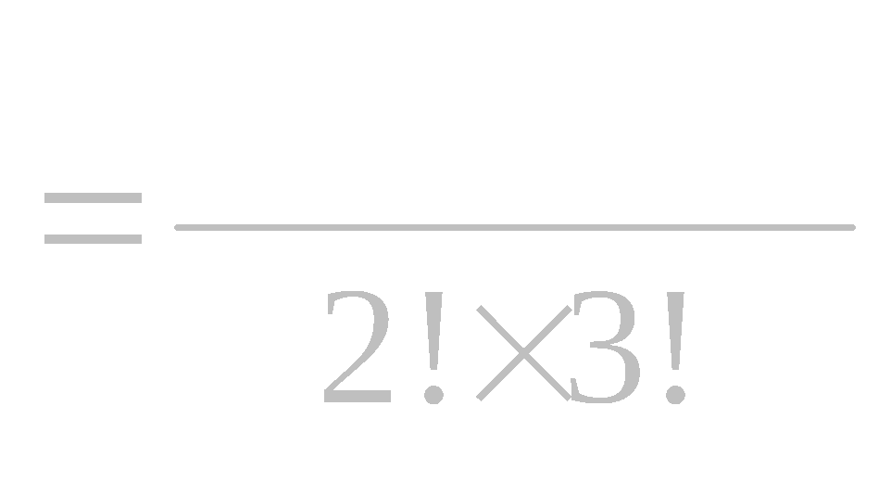
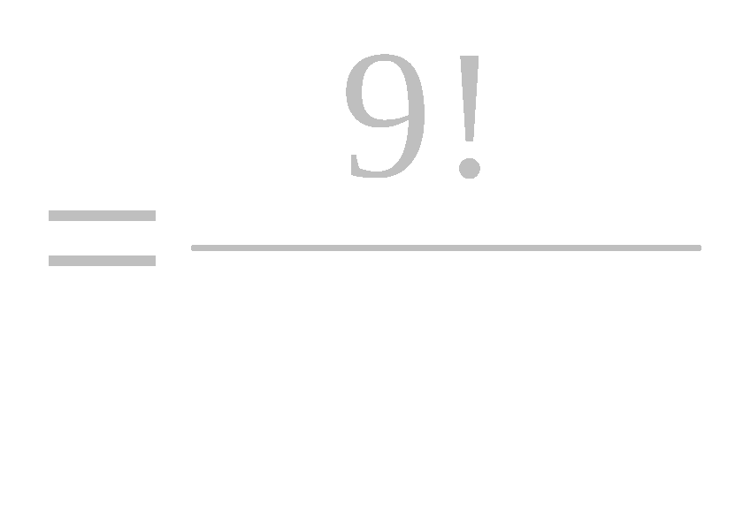
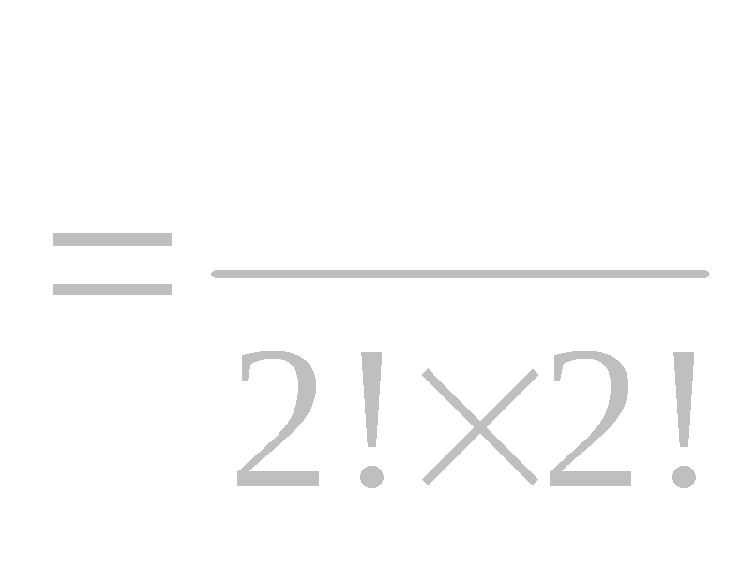
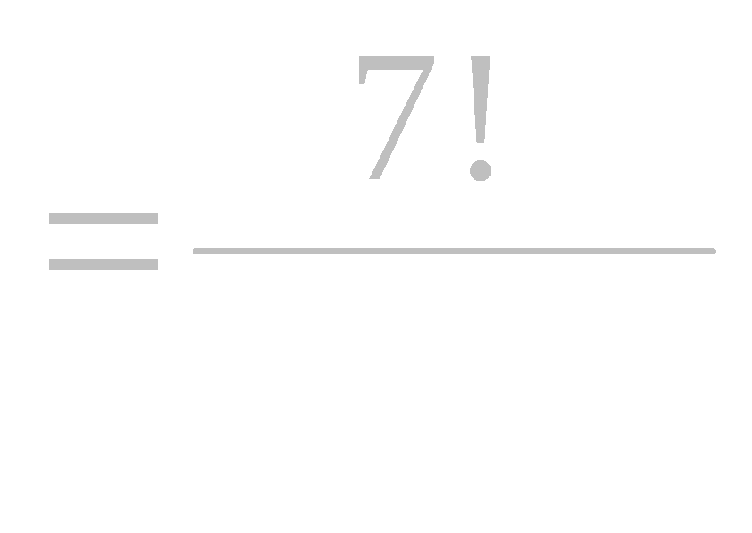

Pg.27, No.20.
In the word CONSONANTS, there are 10 letters, 1 C's , 2 O's , 3 N's , 2 S's , 1 A's and 1 T's .
The number of arrangement ways
( _ _ ) _ _ _ _ _ _ _ _
The number of arrangement ways such that the two O's always come together
The number of arrangement ways such that begin with the three N's
_ _ _ / _ _ _ _ _ _ _

Slide 24
2 O’s together
Begin three ‘N’
2 O’s together and not begin 3 N’s
2 O’ s not together and begin 3 N’s
2 O’s together and begin 3 N,s

Slide 25
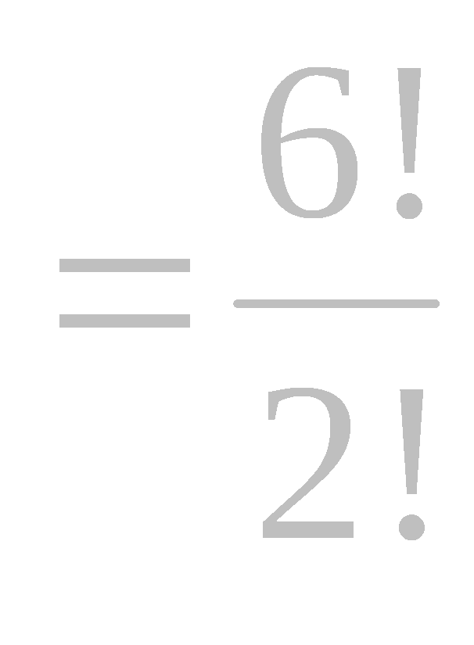


The number of arrangement ways such that the two O's always come together and begin with 3 N’s
__ __ __ / __ __ __ __ __ __ __
The number of arrangement ways such that the two O's always come together and do not begin with 3 N’s
The number of arrangement ways such that the two O's never come together and begin with N’s

Slide 26
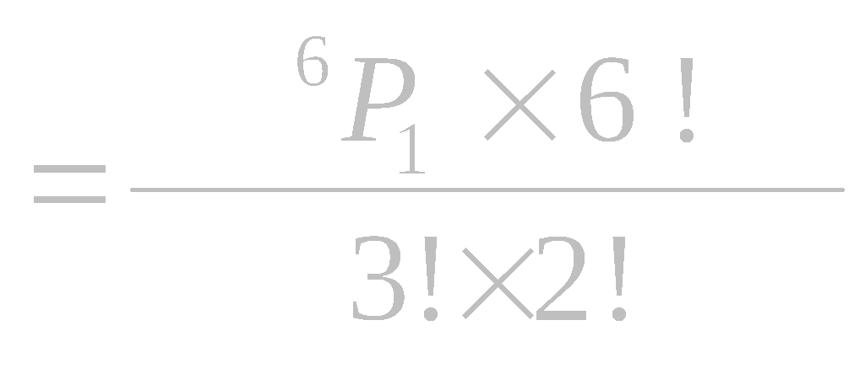

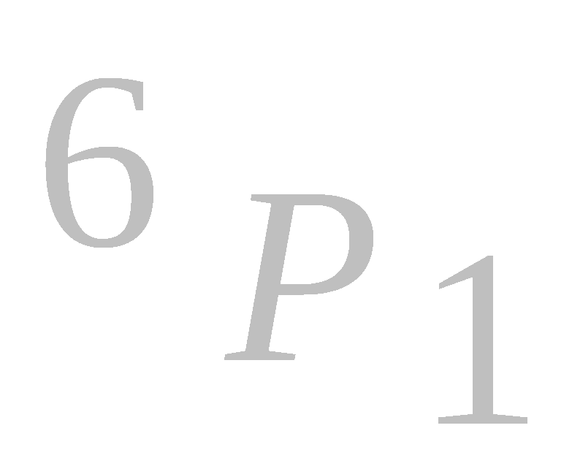
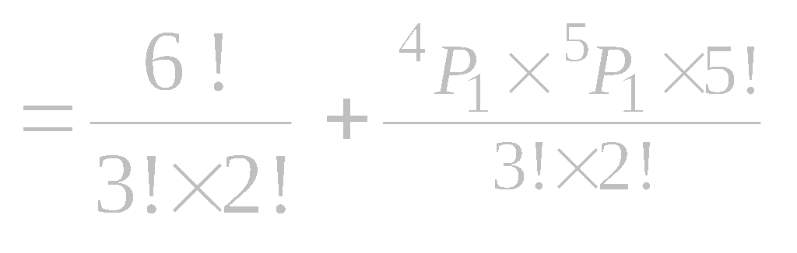
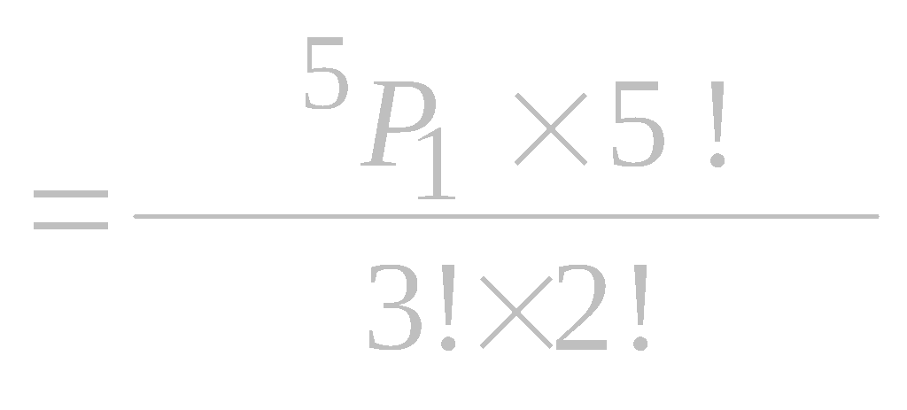
Pg.27, No.21.
The maned of digits are 2 , 2 , 2 , 3 , 3 , 4 , 0 .
The no. of number over 2000000
__ __ __ __ __ __ __
The no. of even number over 2000000 numbers =
The no. of odd number over 2000000 numbers =

Slide 27
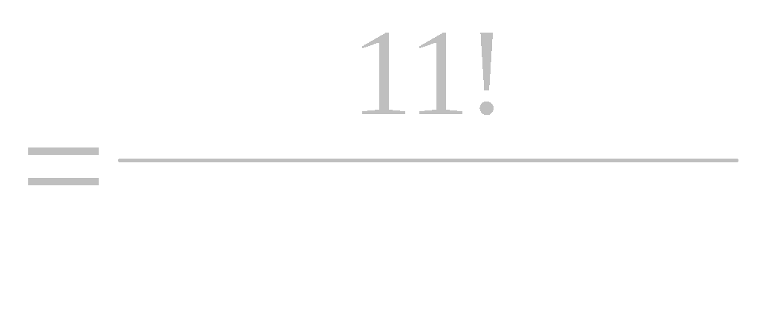
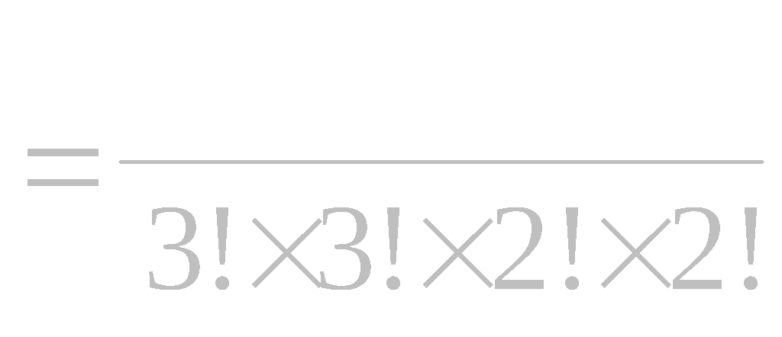
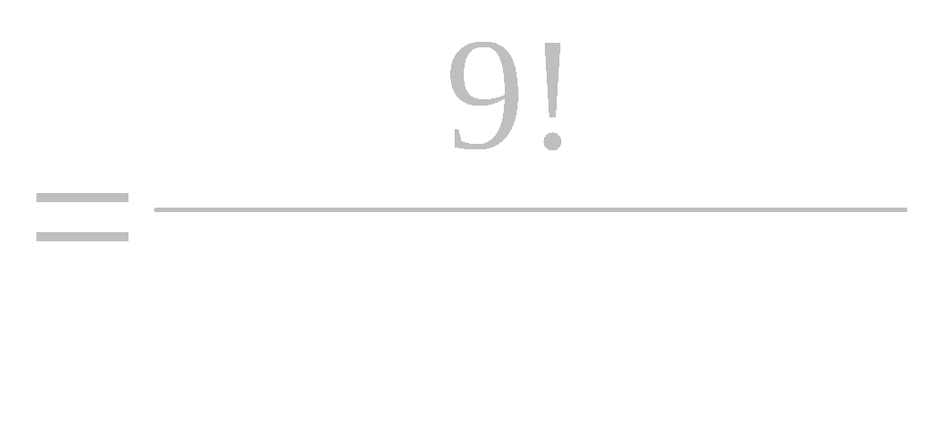
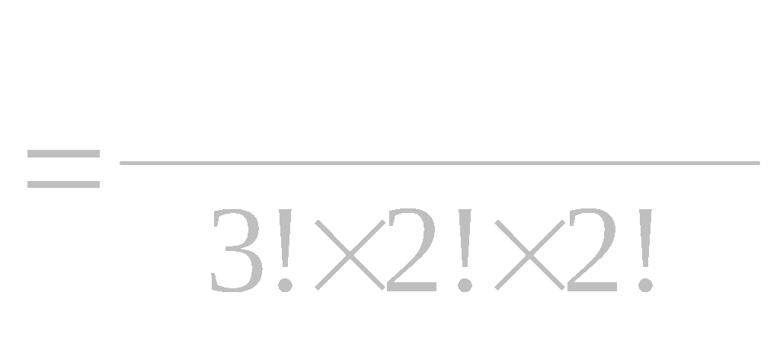


Pg.27, No.22.
In the word ENGINEERING, there are 11 letters, 3 E's , 3 N's , 2 G's , 2 I's and 1 R's .
The number of arrangement ways
The number of arrangement ways such that the three E's
always come together
The number of arrangement ways such that begin with the three E's
and end N

Slide 28




Pg.27, No.23
In the word CHARACTERISTICS, there are 15 letters, 3 C's , 1 H's , 2 A's , 2 R's , 2 T's , 1 E's ,2 I's and 2 S's .
The number of arrangement ways
The number of arrangement ways such that the two R's always come together
The number of arrangement ways such that two R's do not come together

Slide 29
2 T’s together
three C’s together
2 T’s together and 3 C’s not together
2 T’ s not together and 3 C’s togrther
2 T’s together and 3 C,s together

Slide 30



The number of arrangement ways such that the
two T's always come together
The number of arrangement ways such that two T's
come together and 3 C's come together
The number of arrangement ways such that two T's come together and 3 C's do not come together
The number of ways that the two T's and 2 C’s are always come together =
The number of ways that the two T's together and 2 C’s together =

Slide 31






Combination
The number of combination of n different things taken r at time is

Slide 32





Pg.28 , No.31
In a decagon, there are 10 sides and 10 corners.
The number of triangles can be formed by joining the angular points
The number of straight line can be formed
The number of diagonals can be formed by joining the angular points
The name of diagonals can be formed by joining the angular points
Above problem consider in Polygon.

Slide 33



Combination Under Restrictions
The number of combination of n things taken r at time in which p particular things always occur is
The number of combination of n things taken r at time in which p particular things never occur is

Slide 34



Pg 29 , No.41 .
The number of boys = 25
The number of selected boys = 11
The number of ways that 6 of then being always exclude
The number of ways that 5 of then being always include
The number of ways that 6 of then being always exclude and 5 of then always include

Slide 35




Pg.29 , No.36.
The number of persons in a committee = 5
The number of boys = 25
The number of girls = 10
25 boys | 10 girls
5 4 3 2 1 0 | 0 1 2 3 4 5

Slide 36






Pg 29 , No.36.
The number of persons in a committee = 5
The number of boys = 25
The number of girls = 10
The number of committees, so as to include at least one girls

Slide 37





Pg.29 , No.42 .
The number of persons in a committee = 5
The number of boys = 6
The number of girls = 3
6 boys | 3 girls
5 4 3 2 | 0 1 2 3

Slide 38



Pg.29 , No.42 .
The number of persons in a committee = 5
The number of boys = 6
The number of girls = 3
The number of committees, so as to include at
least 3 boys

Slide 39




Pg.29 , No.43 .
The number of persons in a committee = 7
The number of boys = 10
The number of girls = 8
10 boys | 8 girls
7 6 5 4 3 2 1 0 | 0 1 2 3 4 5 6 7

Slide 40






Pg.29 , No.37 .
The no. of engineers = 10
The no. of chemists = 5
The no. of mathematics = 7
The no. of committeess to contain 4 engineers ,2 chemists and 2 mathematics
The no. of committeess to contain 4 engineers ,2 chemists and 2 mathematics such that particular 2 engineers, 1 chemists include and 1 mathematics exclude

Slide 41




Permutation and Combination From two Sets
If m different things of one kind, and n different things of another kind are given the number of permutation which can be formed, containing r of the first and s of the second is

Slide 42






The named of digits are 0 , 1 , 3 , 4 , 5 , 7 , 9.
The number of 6 digits number so as to contain the digit 0 ,4 , 5
0,4,5,
__ , __ , __
_ _ _ _ _ _
The number between 400000 and 600000 digits number so as to contain the digit 0 , 4 , 5
0,4,5,
__ , __ , __
_ _ _ _ _ _
The number of 6 digits number so as to contain the digit 0 ,4 , 5 which are divisible by 5

Slide 43

The number of 6 digits number so as to contain the digit 0 ,4 , 5 which are divisible by 5 = ?
0,4,5,
__ , __ , __
_ _ _ _ _ 0 + not zero _ _ _ _ 5
The number of 6 digits even number so as to contain the digit 0 ,4 , 5 = ?
The number of 6 digits odd number so as to contain the digit 0 ,4 , 5 = ?

Slide 44








Pg .29 , N0.39.
There are 7 letters in the word FOMULA
The number of vowels = 3
The number of consonants = 4
4 consonants | 3 vowels
3 2 1 0 | 0 1 2 3

Slide 45







Pg 29 , No.39 .
In the word FORMULA, there are 7 letter
The number of consonants = 4
The number of vowels = 3
The number of 3 letter words, so as each words containing one vowel at least
The number of 3 letter words, so as each words containing at least one vowel and begin with vowel

Slide 46







Pg 29 , No.44
The number of vowels = 5
The number of consonants = 15
The number of letters in a word =5
15 consonants | 5 vowels
5 4 3 2 1 0 | 0 1 2 3 4 5

Slide 47




pg.29 , No. 44
The number of vowels = 5
The number of consonants = 15
The number of 5 letters words so as to containing the 3 different vowels and 2 different consonants
The number of 5 letters words so as to containing the at most 2 consonant

Slide 48










The number of 5 letters words so as to containing the 3 different vowels and 2 different consonants and centlal may be vowel
( 3 V , 2 C ) __ __ __ __ __
The number of 5 letters words so as to containing the at most 2 consonant and begin with vowel

Slide 49









The number of 5 letters words so as to containing the at most 2 consonant and begin with vowel

Slide 50



pg 30 , No 45 .
The number of vowels = 5
The number of consonants = 10
First, we take the the vowel “ a ”
10 consonants | 4 Vowels + a
4 3 2 1 0 | 0 1 2 3 4

Slide 51








Pg30 , No.45.
The number of consonants = 10
The number of vowels = 5
The number of 5 letters words so as ' a ' is always include and the words is to contain at least 2 consonants
The number of 5 letters words so as ' a ' is always include and the words is to contain at least 2 consonants and begin with “a”

Slide 52











The number of 5 letters words so as ' a ' is always include and the words is to contain at least 2 consonants and begin with vowel
The number of 5 letters words so as ' a ' is always include and the words is to contain at least 3 consonants and vowels are separated

